Slide 1
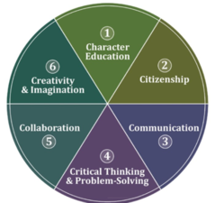
Power4Learning Award
Hannah 2016

Slide 2
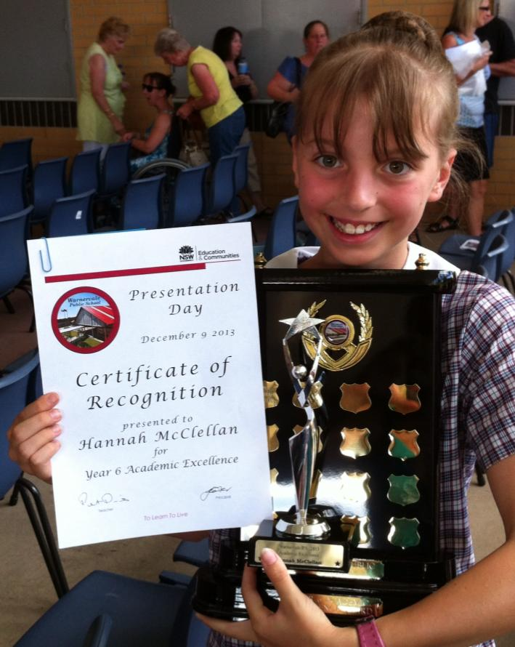
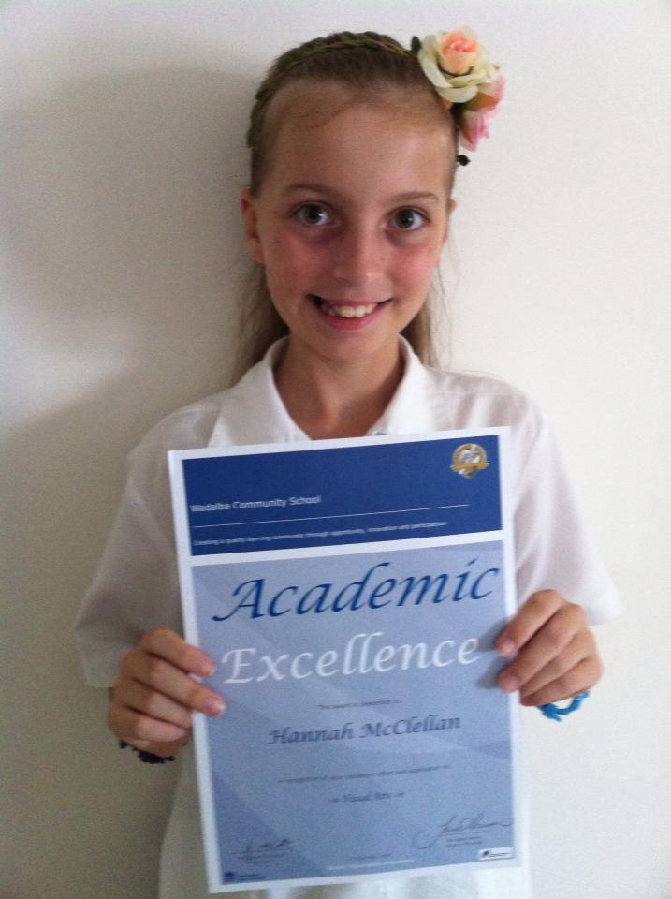
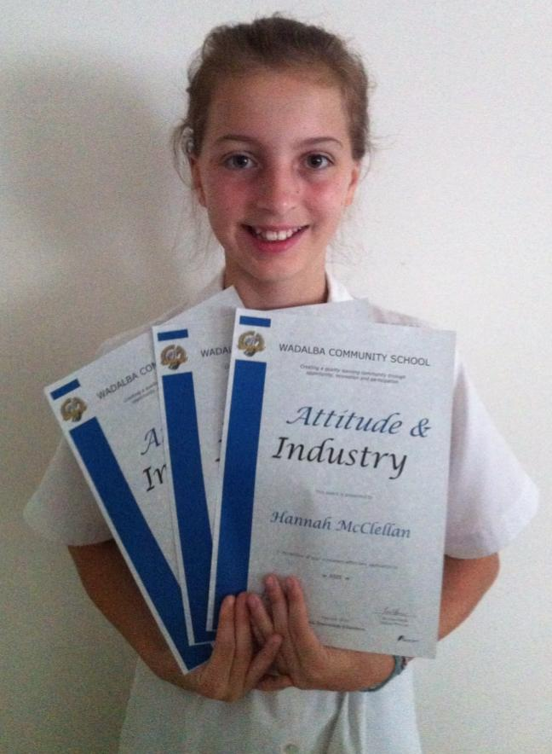
School
On my last report card, I received 91% of Always for the School Values tick boxes, as well as Outstanding or High on all of my subjects.
I am extremely close to achieving my Gold Award. Once I have achieved this, it can go alongside many of my other academic awards, such as my 3 Attitude and Industry Awards, my Academic Excellence Awards and my Year 6 Academic Excellence (Dux) Award.

Slide 4
School experience
During my 3 years at Wadalba, I have participated in many school activities including:
Wadalba’s Got Talent - 2014 and 2016 (competed and helped manage)
CAPA Showcase - 2015 and 2016 (performed and helped manage)
Trivia Night - 2014 (performed)
Grease: The Mini Musical (Assistant Musical Director and Band)

Slide 5
Local community experience
My local community experience has been
volunteering at the Central Coast
Eisteddfod in numerous roles, including
being a backstage manager and
photographer for the past 3 years.
I also have been in an article asking for more volunteers to save the eisteddfod.

Slide 6
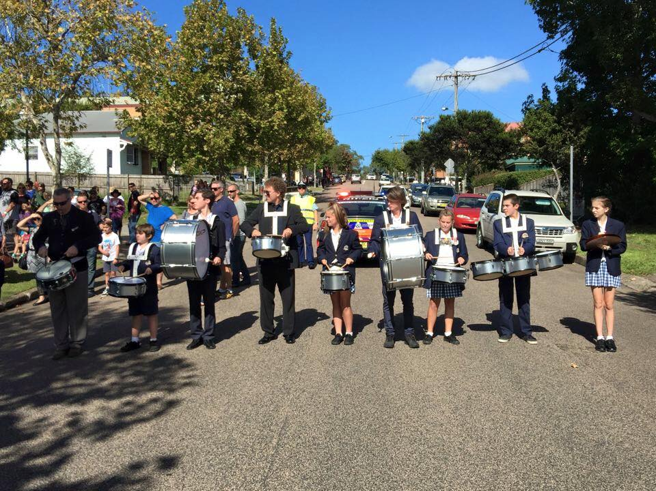
Local community experience
Another local community event I have participated in is the Wyong ANZAC Day March. I represented the school this year and hope to represent again proudly next year.
I also volunteered at William Cape Gardens Nursing Home this
year for 2 terms as part of the school’s volunteering program.
You may see me at assemblies as I am in Tech Crew. I have
been in it from the beginning of Year 7 and hope to continue
until the end of Year 12.

Slide 7
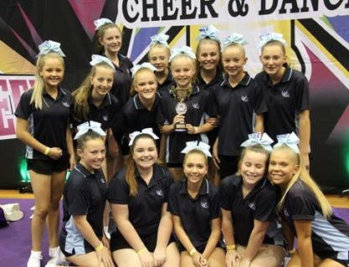
Regional/state experience
My state learning experience is competing
in Australian All Stars Cheerleading
Federation Spring Carnival with 13 other
girls, representing WCS. This experience
has taught me teamwork and trust.

Slide 8
Global learning experience
I founded the WCS Musicians group where the CAPA and Music Elective students can talk about anything music-related.
https://www.facebook.com/groups/946991025325792/
I also recently collaborated with the members of Tech Crew
to create a Facebook page where we post what we have been doing.
https://www.facebook.com/wsctechcrew/?ref=aymt_homepage_p
This has taught me communication skills and helped me find people who have similar interests.

